Slide 1

Artificial Intelligence
A Broad Overview
Notes:
I chose this theme for the simple reason that it was the only one that I could find which had anything to do with computers. I didn’t really have a lot of choice with that, but I am happy with the way that it turned out
Music sourced from: http://www.bensound.com

Slide 2
Overview
History
Old Times
Dartmouth Conference
1st AI Winter
1st AI Boom
2nd AI Winter
2nd Boom - Now
Sub-Topics of AI
Where does that leave us?

Slide 3
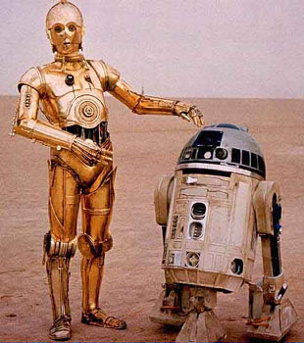
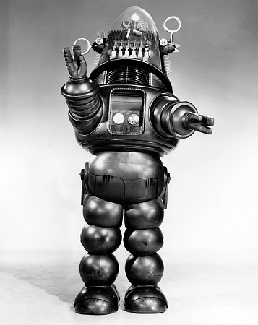
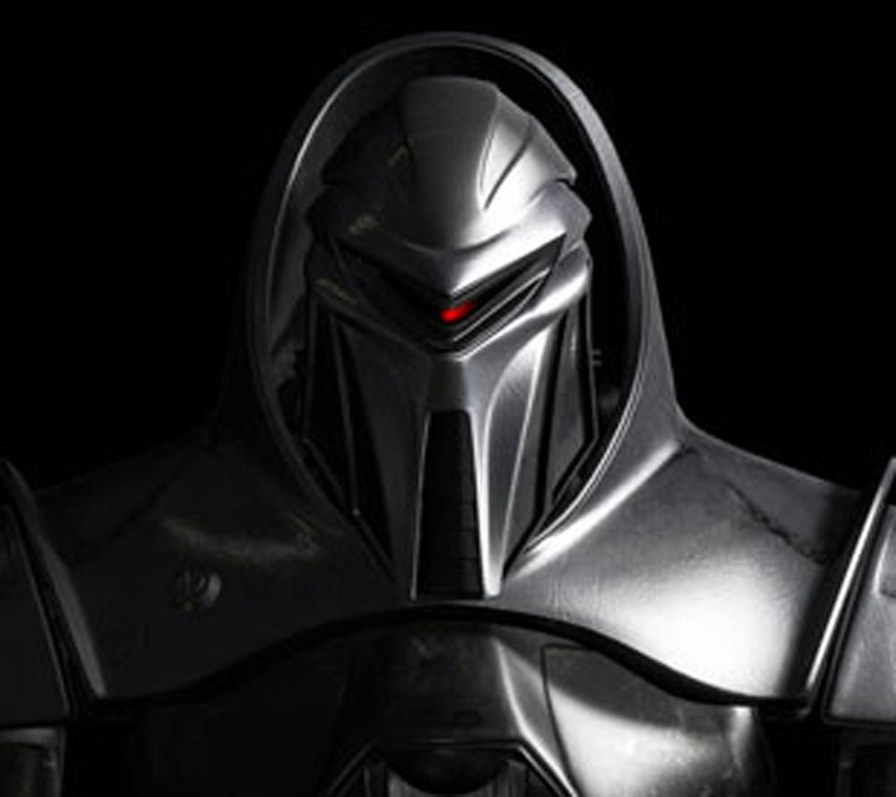

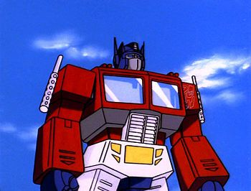
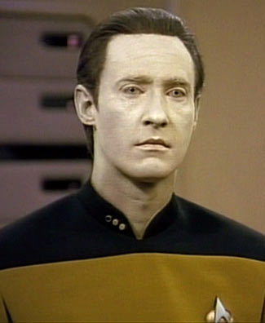
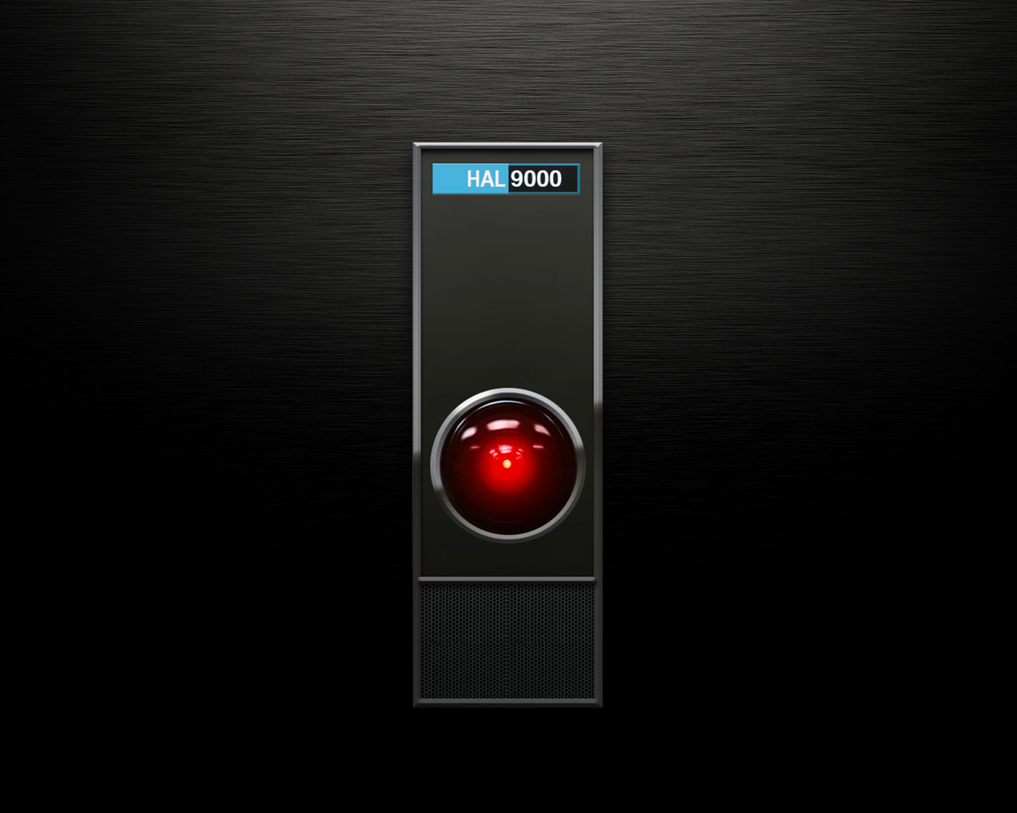
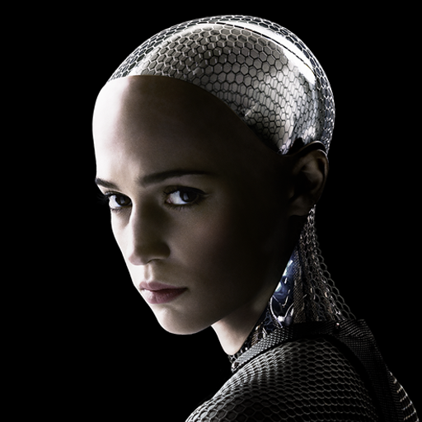
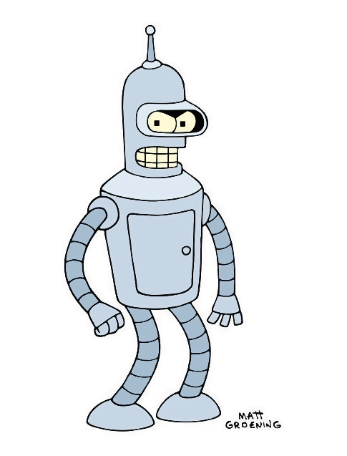
Notes:
Images sourced from: http://www.imdb.com/title/tt0017136/
http://flashbak.com/r2-d2-c-3po-tv-stars-40295/
http://2001.wikia.com/wiki/HAL_9000
https://twitter.com/exmachinamovie
http://hubpages.com/entertainment/Robby-The-Robot
http://herocomplex.latimes.com/tv/caprica-wiped-out-syfy-cancels-planet-before-cylons-get-chance/
http://tfwiki.net/wiki/Optimus_Prime_(G1)/Generation_1_cartoon_continuity
https://en.wikipedia.org/wiki/Data_(Star_Trek)
http://futurama.wikia.com/wiki/Bender_Bending_Rodr%C3%ADguez

Slide 4
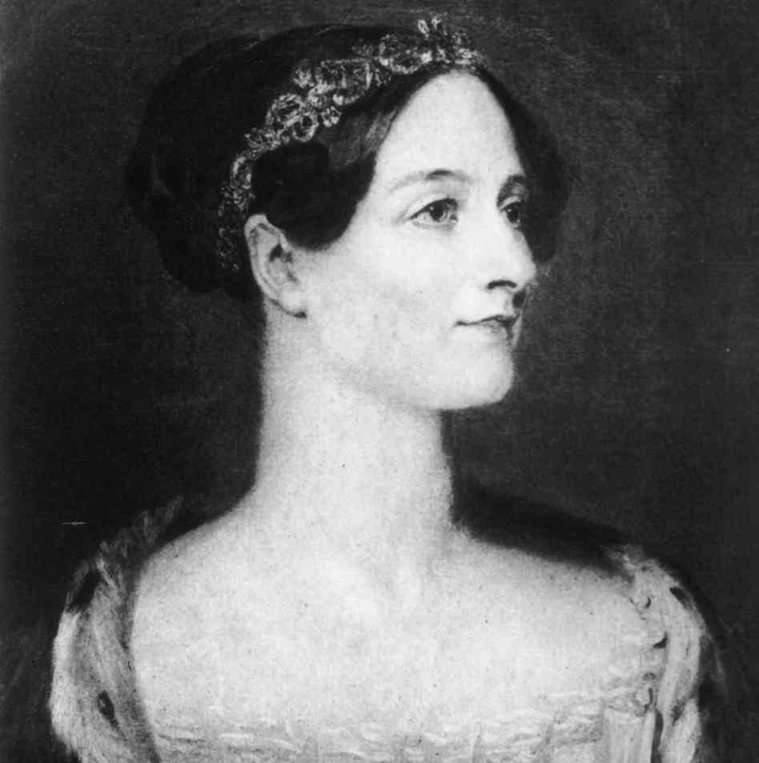
History: the Old-Timers
Ada Lovelace (1815-1852)
Ada Lovelace is thought to be the mother of modern programming
Notes:
Image sourced from: http://www.wbur.org/npr/345799830/the-forgotten-female-programmers-who-created-modern-

Slide 5
History: the Old-Timers
Alan Turing (1912-1954)
Father of modern computing
Became involved in AI before death
Invented Turing Test

Slide 6


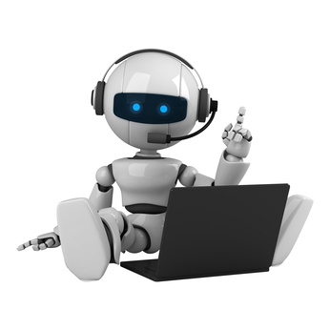
The Turing Test
Notes:
Images sourced from: http://inspiratron.org/blog/2015/02/04/worries-artificial-intelligence/
http://www.irishcentral.com/culture/entertainment/ten-irish-expressions-youll-have-no-clue-what-they-mean-237521471-239669151.html
http://rickmcnary.me/networking-101-using-twitter-to-build-relationships

Slide 7
History: The Dartmouth Conference
McCarthy and Minsky Organized in 1956
Introduced First AI system, the Logic Theorist
Most people who became heads of the field attended

Slide 8
History: Outcomes of the Conference
Shortly after, AI that could:
Play simple games
Communicate in plain English
SHRDLU
Built simple robots
Turtles
The John Hopkins Beast

Slide 9

within ten years a digital computer will be the world's chess champion
H.A. Simon, 1958
Notes:
Image sourced from: http://www.mywalkthrou.com/what-is-a-check-in/

Slide 10

machines will be capable, within twenty years, of doing any work a man can do.
H.A. Simon, 1965
Notes:
Image sourced from: http://cod.esportspedia.com/w/index.php?title=File:RedX.png

Slide 11
Within a generation ... the problem of creating 'artificial intelligence' will substantially be solved.
Marvin Minsky, 1967
Notes:
Image sourced from: http://cod.esportspedia.com/w/index.php?title=File:RedX.png

Slide 12
In from three to eight years we will have a machine with the general intelligence of an average human being.
Marvin Minsky, 1970
Notes:
Image sourced from: http://cod.esportspedia.com/w/index.php?title=File:RedX.png

Slide 13
History: The 1st AI winter
Causes
Overconfidence
The Perceptron
Neat vs. Scruffy divide

Slide 14
History: 1st AI Boom
The rise of the expert system
The creation of massive databases of information
Explosion in funding
The revival of Neural Networks

Slide 15
History: 2nd AI winter
Budget Cuts

Slide 16
History: the 2nd AI Boom - Now
Now, AI is everywhere
The rise of intelligent agents
The Neats won

Slide 17
Subfields of AI
Machine Learning
Natural Language Processing
Machine Perception
Computer Vision
Speech Recognition
Motion
Manipulation
Social Intellegence
Affective Computing
Computational Creativitty
General Intellegence
Cybernetics
Symbolic AI
Cognitive simulation
Logic
Sub-Symbolic Computing
Embodied Systems
Agent Architectures
Optimization
Probabilistic Models
Decision Theory
Utility Theory
Classifers
Neural networks
Deduction
Reasoning
Problem Solving
Knowledge Representation
Commonsense Knowledge
Default Reasoning
Automated Planning

Slide 18
Subfields of AI: Neural Networks
Models Neurons with Programming or Linear Algebra
Several neurons make up a layer, and then that layer is connected to more layers
Used in:
Computer Vision
Robotics
Classification Problems

Slide 19
Subfields of AI: Natural Language Processing
Uses a variety of statistical methods to evaluate natural language
Naïve-Bayes Classifiers
Semantic Nets
Hidden Markov Models
Used for things like:
Machine Translation
Sentiment Analysis

Slide 20
Where does that leave us?
AI Today
Big Dog
Deep Blue
Watson
Siri
Google

